Slide 1
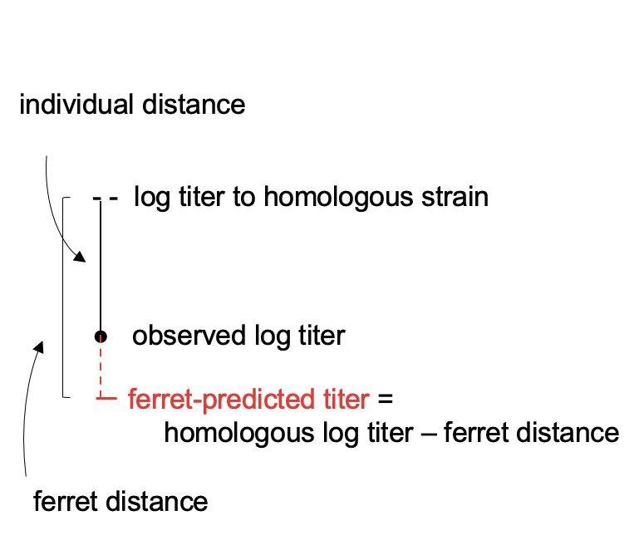
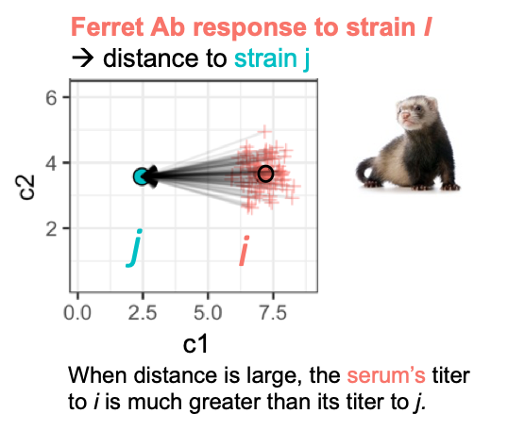
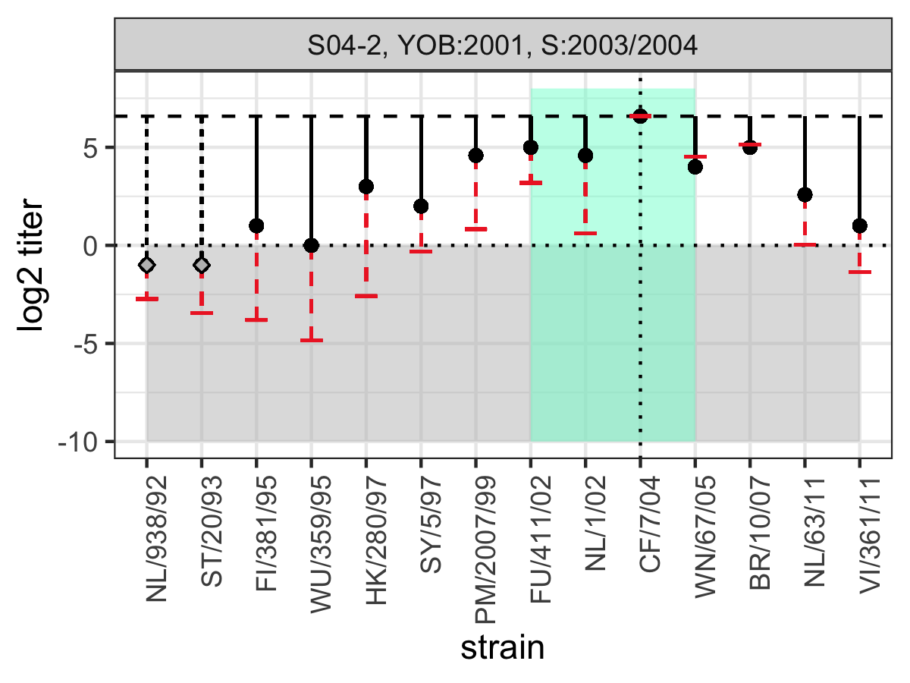
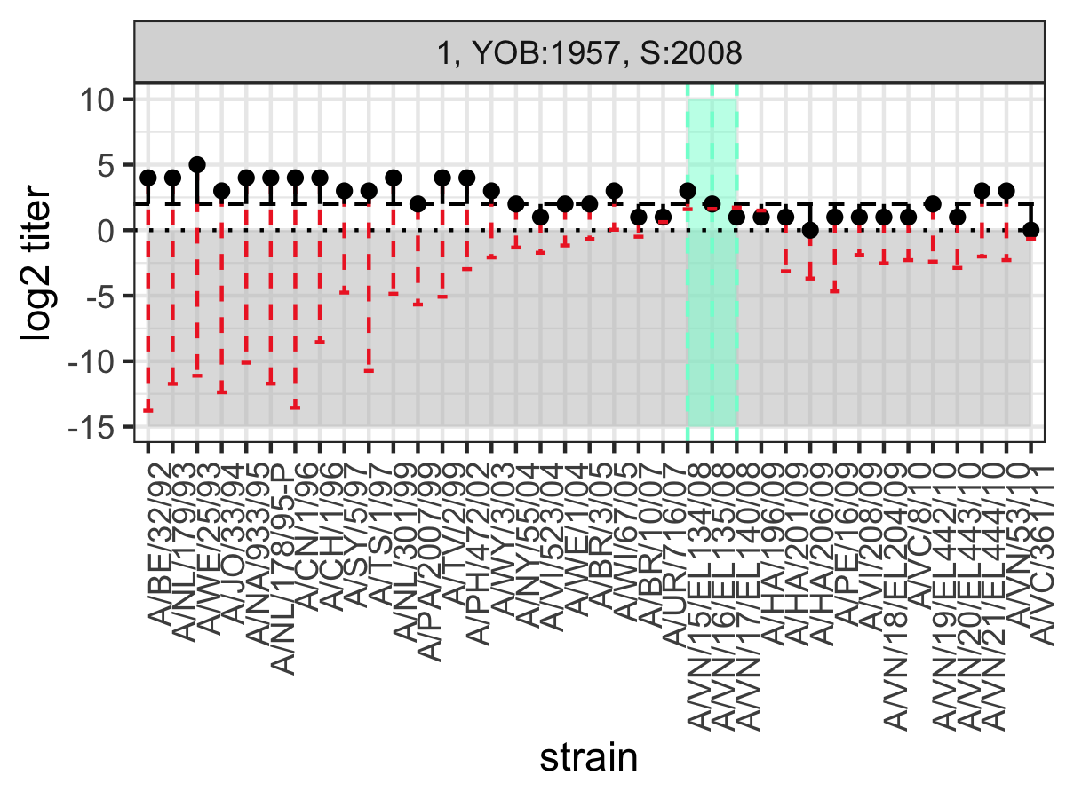
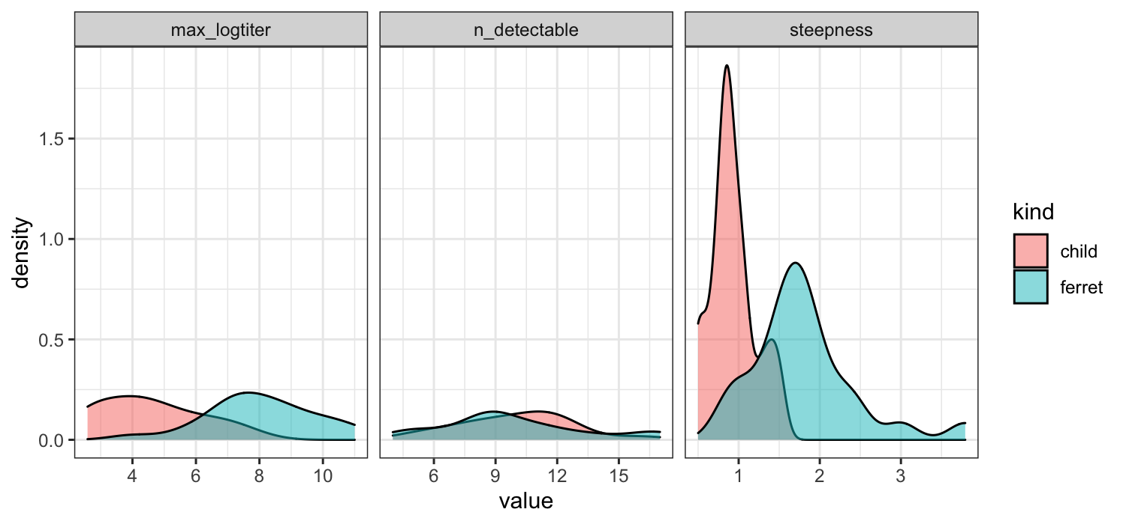
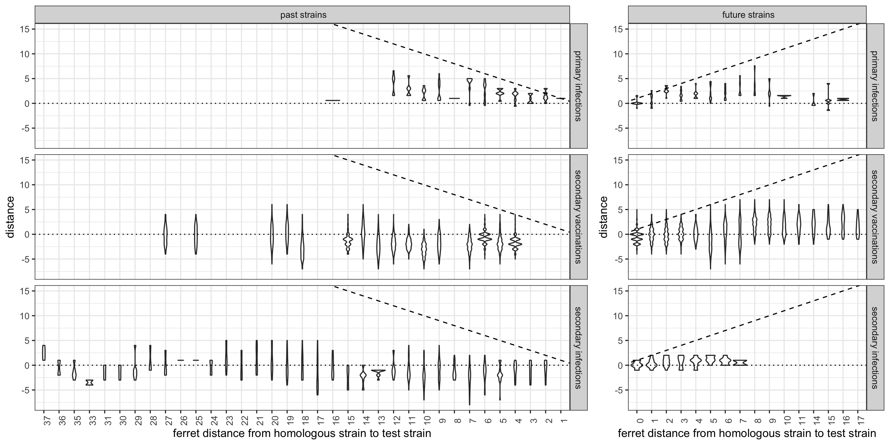
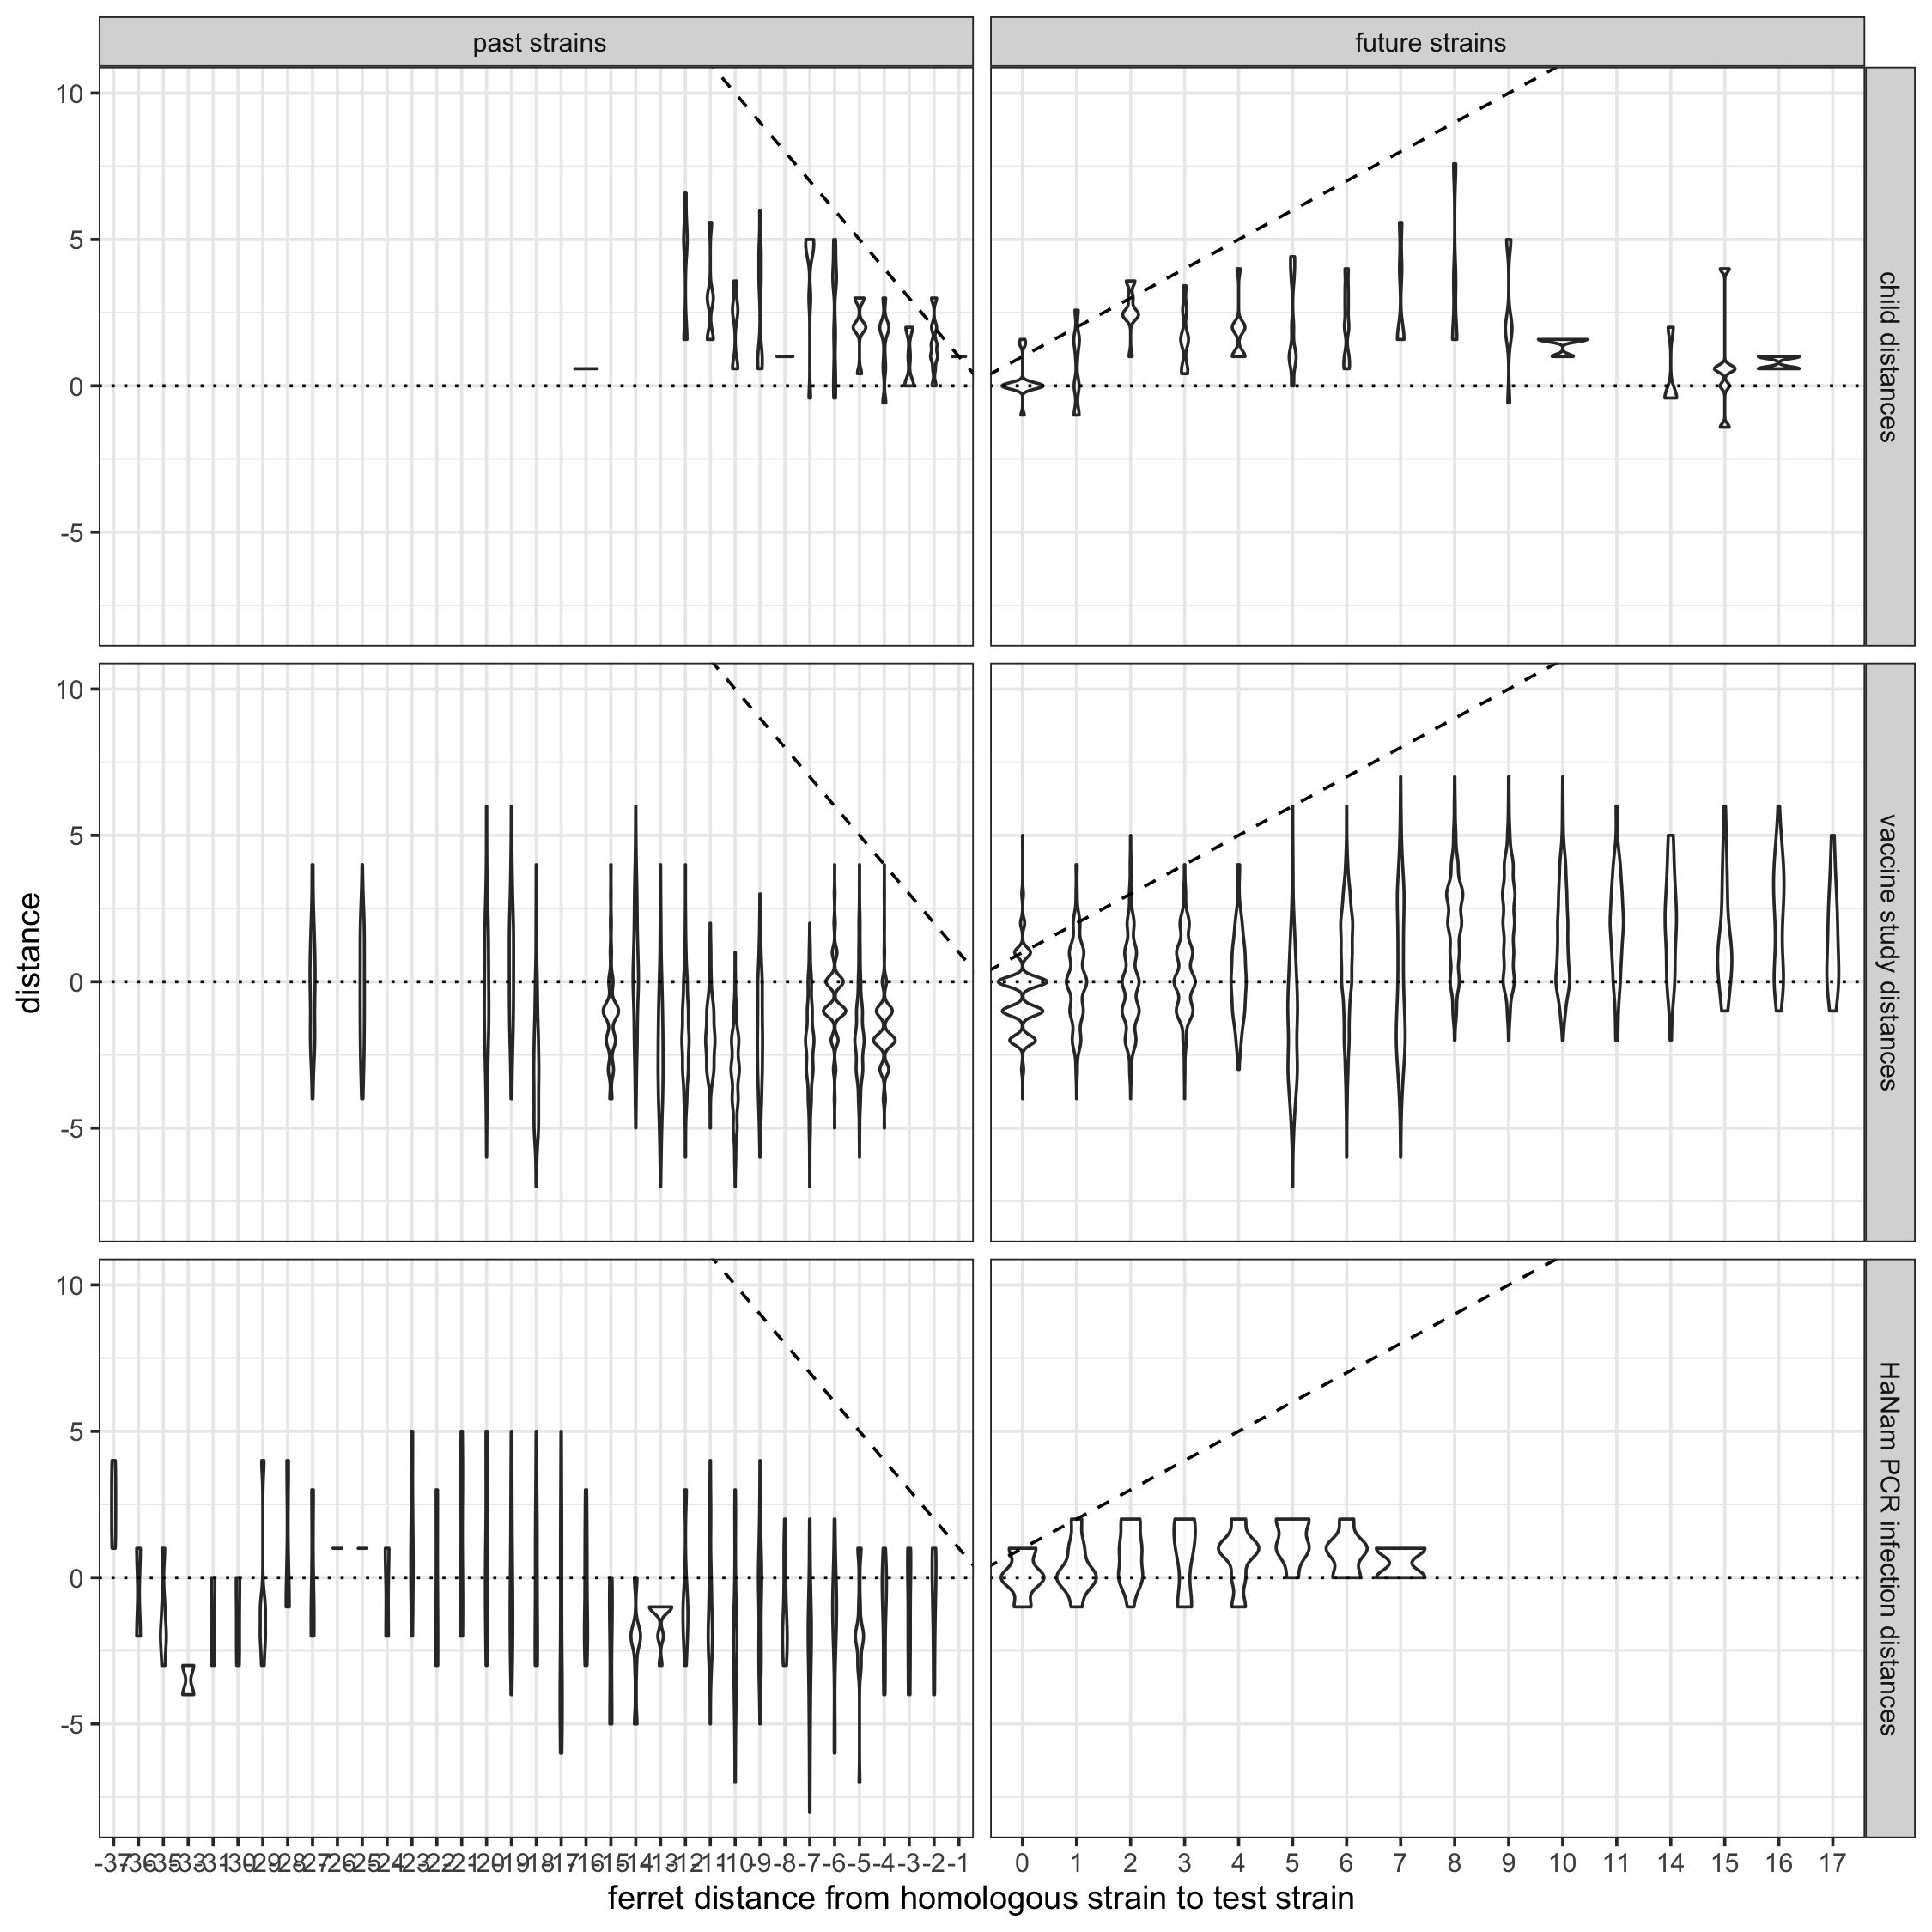
Fig. 1
Ferret distances systematically overestimate human distances:
primary antisera
secondary antisera (infection)
secondary antisera (vaccination)
x: ferret distances
y: individual distance
Violins or scatter
A.
B.
C.
individual distance
log2 titer to homologous strain
log2 titer to test strain
predicted log2 titer =
homologous log2 titer –
ferret distance
← past
1º infection
future →
ferret distance
D.
F.
← past
2º infection
future →
log2 titer
G.
E.

Slide 2
Fig. 1
Ferret distances systematically overestimate human distances:
primary antisera
secondary antisera (infection)
secondary antisera (vaccination)
x: ferret distances
y: individual distance
Violins or scatter
D.
A.
C.
D.
F.
D.
B.
G.
E.
Notes:
Fig. panel sources:
A. Copied from CEIRR_Project3_May162022.pptx
B. Copied from CEIRR_Project3_May162022.pptx
C. Exported into `draft_manuscript_figures` by `Fonville_2016/R/Fonville_2016_analysis.Rmd`
D. Exported into `draft_manuscript_figures` by `Fonville_2016/R/Fonville_2016_analysis.Rmd`
F. Copied from CEIRR_Project3_May162022.pptx
G. Exported by `Fonville_2016/R/Fonville_2016_analysis.Rmd` into `Fonville_2016/plots/`
E. Exported into `draft_manuscript_figures` by `Fonville_2016/R/Fonville_2016_analysis.Rmd`

Slide 3
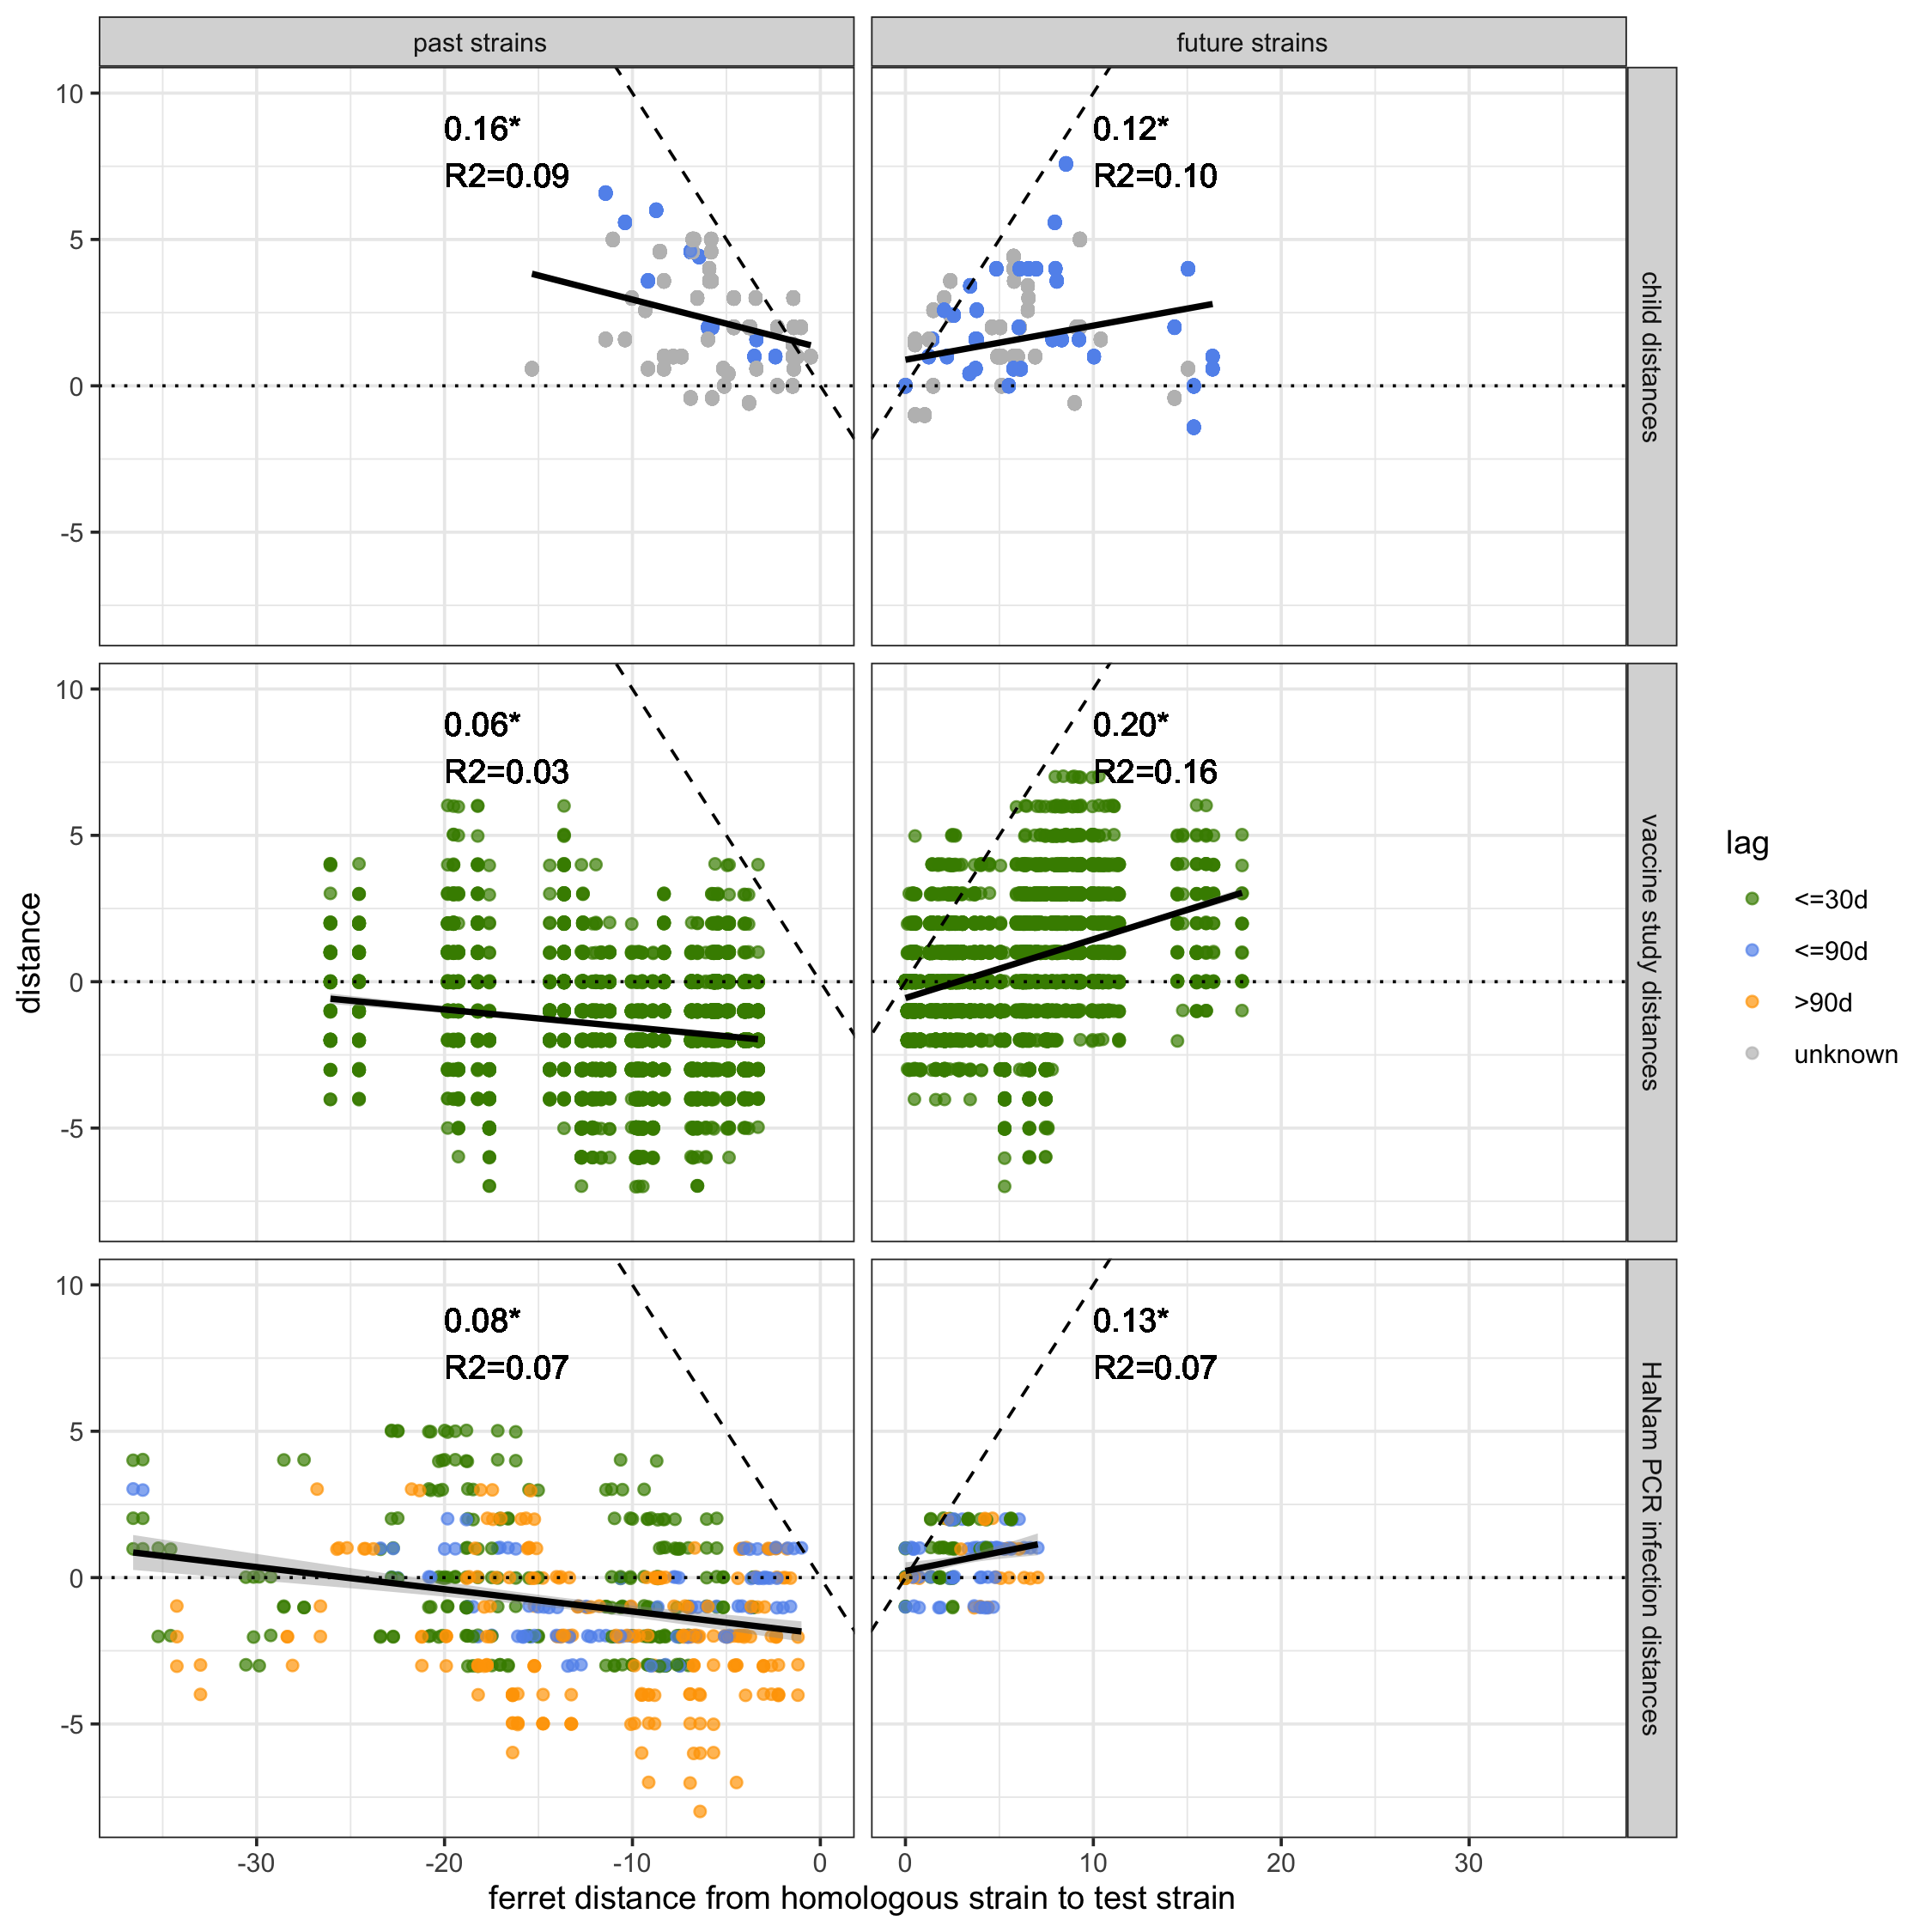
Fig. 1
G.
A.
D.
Fraction of individuals with individual distances >2 units from adjusted ferret distance.
infected adult
child
vax adult
B.
E.
H.
Fraction of distances that are negative, but predicted to be positive.
C.
F.
infected adult
child
vax adult

